Slide 1
Chapter 12 – Part I
Data Collection and Empirical Methods
  Data collection
  Ungrouped Complete Data
  Grouped Complete Data
Notes:
The focus changes now from one of developing and analyzing reliability and maintainability models to the analysis of failure and repair data. We begin by establishing some empirical reliabilities generated directly from failure data that has been collected. Later, we will fit theoretical failure distributions to this same failure data.

Slide 2
Data Collection
Basic problem: Obtain a sample of failure
or repair times:
t₁ , t₂ , t₃ , . . . t_{n} ; and
determine the most appropriate reliability
or maintainability model (i.e. find R(t) or f(t)).
t_{i} represents the failure time of the ith unit or the ith observed
repair time. The t_{i} are assumed to be an independent sample
from the same population.
Chapter 12
Notes:
The primary problem to be addressed in Part II of text is:
- given a set of failure (or repair) times,
what is the most appropriate model to use.
Individual failure times will represented by t_{i}, the time of the i^{th} failure (or repair). The set of failure times are assumed to be from a random sample (independent draws from a given population).

Slide 3
Taxonomy of Failure Data
Operational vs. test-generated failures
grouped vs. ungrouped data
large vs. small samples
complete vs. censored data
  singly censored - operating times the same
    Type I censored - time terminated test
    Type II censored - terminated at r failures
  multiply censored - operating times differ
Chapter 12
Notes:
Failure data is either actual failure times or failure times obtained in a testing environment. Both grouped (failure times fall within some interval) and ungrouped (individual failure times are recorded) data will be addressed. Censored data occurs when not all components at risk have failed. If all units have failed, then the sample is said to be complete. Censored time is the operating (risk) time of a unit that has not failed. If all censored units have the same operating times, then the data is said to be singly censored; otherwise it is multiply censored.

Slide 4
Censoring
x
x
x
x
x
x
x
o
x
o
time on unit
time on unit
(b) Singly Censored
(a) Complete Data
x
o
x
x - failure
o - censor
o
x
time on unit
(c) Multiply Censored
Chapter 12
Notes:
A graphical comparison of complete, singly censored, and multiply censored data.

Slide 5
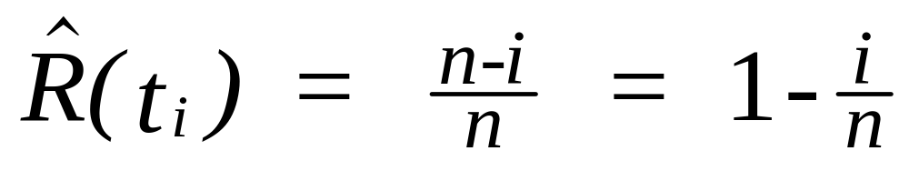
Ungrouped Complete Data
Given t₁ , t₂ , t₃ , . . . t_{n} are ordered failure times
i.e. t_{i} <= t_{i+1}. Then n- i is the fraction surviving at time t_{i}
“hat symbol means it is an estimate”
Chapter 12
Notes:
For ungrouped complete data, an empirical reliability at the time of the i^{th} failure, t_{i}, can be defined as the number that have survived to time t_{i} (n-i) divided by the total number at risk (n).

Slide 6
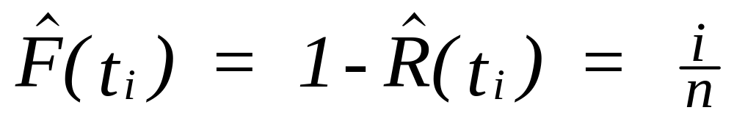
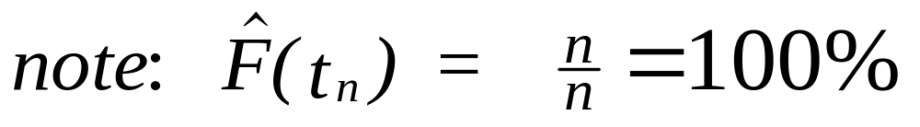
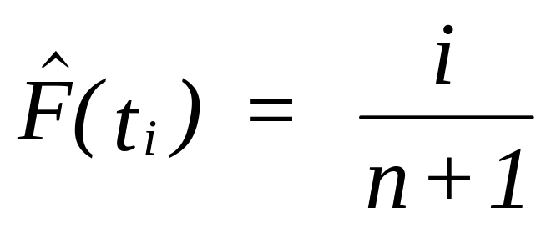
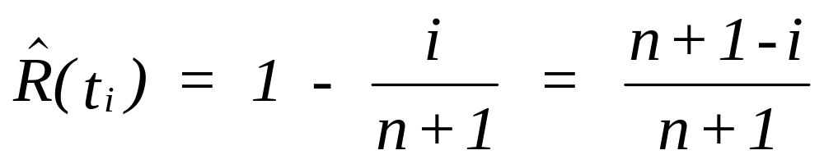
Ungrouped Complete Data
This effect is undesirable,
therefore let:
Chapter 12
Notes:
One disadvantage of this definition is that the reliability at the time of the n^{th} failure is zero. Since in a sample of size n, it is unlikely that it would contain the component that has the longest life, this can grossly underestimate the reliability at time t_{n}. Therefore a better definition is the one given above.

Slide 7
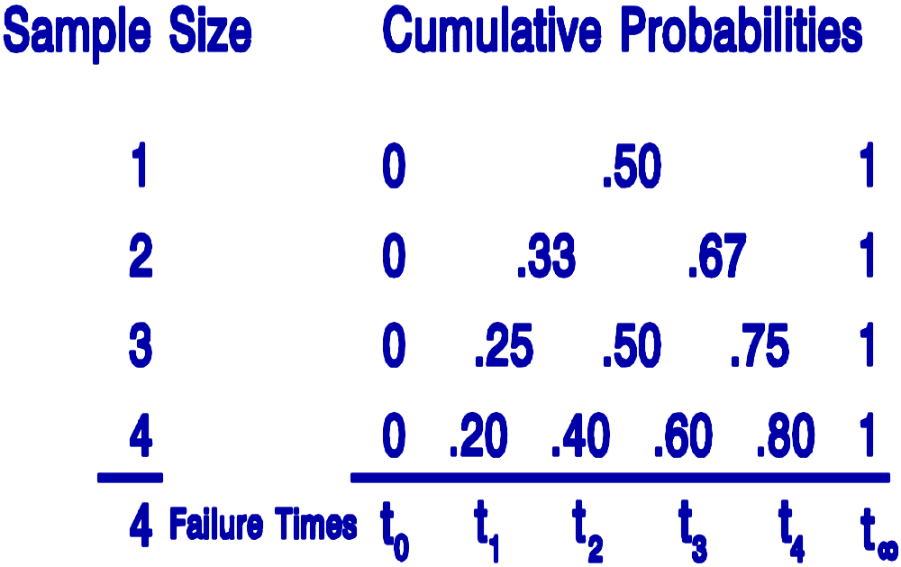
Ungrouped Complete Data
Chapter 12
Notes:
This new definition for the reliability at time t_{i}, allocates equal probability between each failure time beginning with time zero.

Slide 8
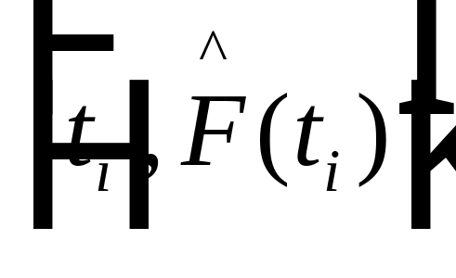
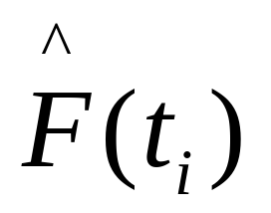
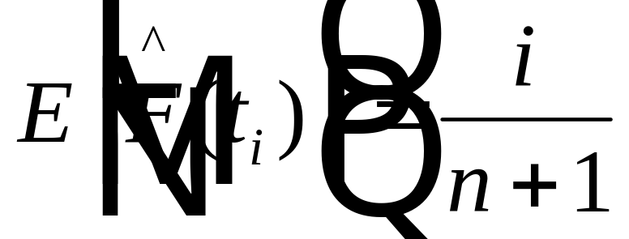
Plotting Positions
is the fraction of observations below the ith
sample observation where
Chapter 12
Notes:
The points on a graph defined by each failure time and its corresponding cumulative failure probability are referred to as plotting positions. There are several different plotting positions depending upon how F(t_{i}) is estimated. The one shown here is referred to as the mean plotting position because i/(n+1) is the mean of the distribution of F-hat.

Slide 9
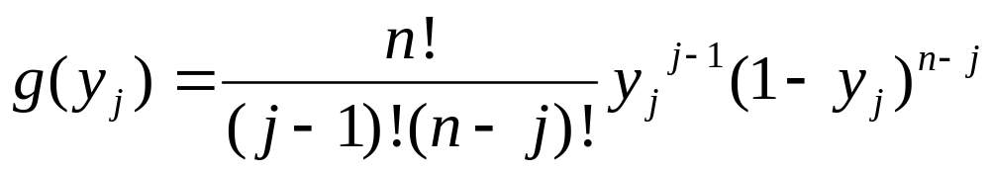
Rank Order Distribution
n = 10
g(y_{j})
j = 1
j = 5
j = 9
^
y_{j} = F(t_{j})
Chapter 12
Notes:
For the j^{th} failure time, F-hat has a beta distribution with parameters j and n. The distribution is highly skewed for j near zero and near n.

Slide 10
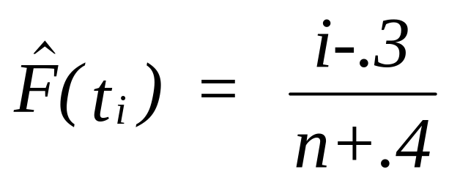
Median Plotting Position
Must be computed numerically
approximated by:
i
i/n
i/(n+1)
median
(i-.3)/(n+.4)
1
.125
.111
.083
.083
2
.250
.222
.201
.202
3
.375
.333
.321
.321
4
.500
.444
.440
.440
5
.625
.555
.560
.560
6
.750
.666
.680
.679
7
.875
.777
.799
.798
8
1.000
.888
.917
.917
Table A.5, p. 465
Chapter 12
Notes:
Shown is a comparison of several plotting positions. The last column is an approximation to the median plotting position. The actual median values must be determined numerically. Table A.5 in the text provides the median plotting positions for 1 <= n <= 50.

Slide 11
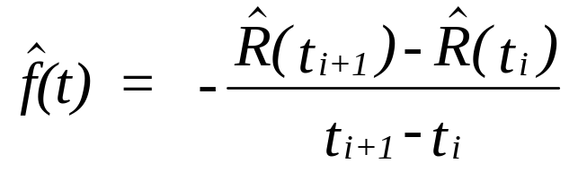
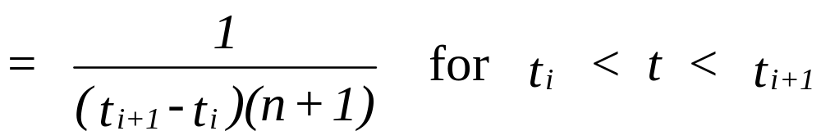
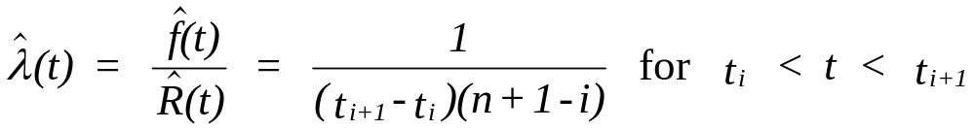
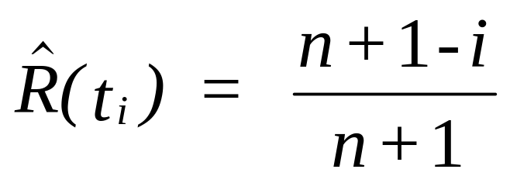
Empirical PDF & Hazard Rate
Chapter 12
Notes:
From the empirical reliabilities, estimates of the PDF and the hazard rate function can be obtained.

Slide 12
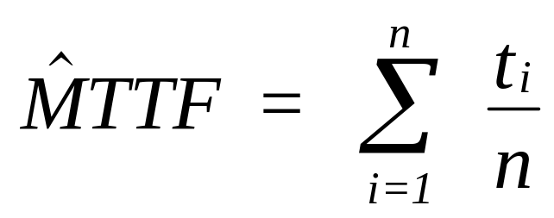
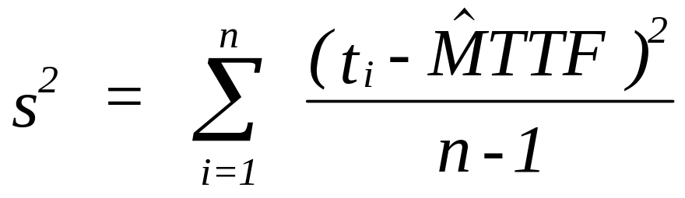
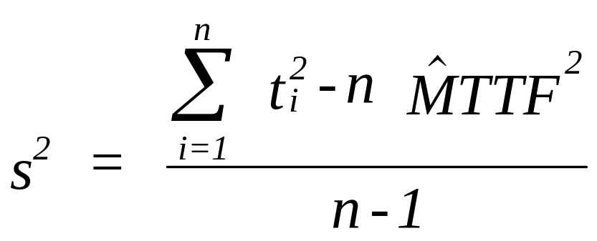
Sample Mean & Variance
Chapter 12
Notes:
The sample mean and sample standard deviation are defined in the usual way.

Slide 13
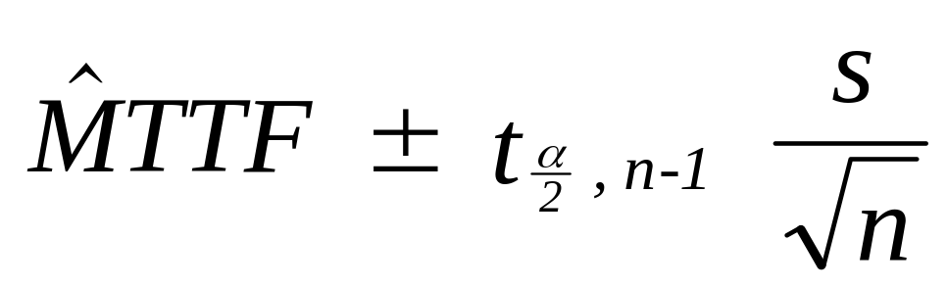
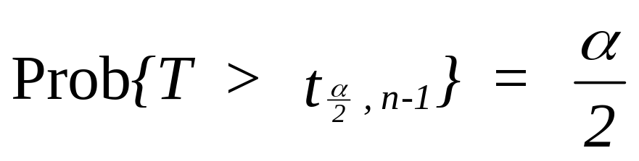
Confidence Interval for the Mean
where
Table A.2, p. 462
Chapter 12
Notes:
Using the central limit theorem, approximate confidence intervals about the MTTF can be found.

Slide 14
Example 12.2
Given the following 10 failure times in hours, estimate R(t), F(t), f(t), λ(t) and compute a 90 percent confidence interval for the MTTF:
24.5, 18.9, 54.7, 48.2, 20.1, 29.3, 15.4, 33.9, 72.0, 86.1
TIME RELIABILITY DENSITY HAZARD RATE
0.0 1.00 .0059 .0059
15.4 .9090 .0260 .0286
18.9 .8182 .0757 .0926
20.1 .7273 .0207 .0284
24.5 .6364 .0189 .0298
29.3 .5455 .0198 .0362
33.9 .4546 .0064 .0140
48.2 .3636 .0140 .0385
54.7 .2727 .0053 .0193
72.0 .1818 .0064 .0355
86.1 .0909
Chapter 12
Notes:
An example from the text. Try generating these values by hand and then use the course software. Unless otherwise indicated, the mean plotting position is used.

Slide 15
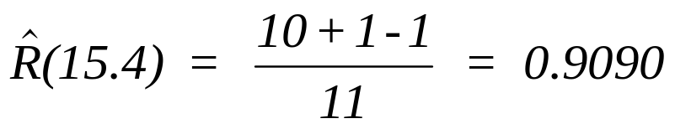
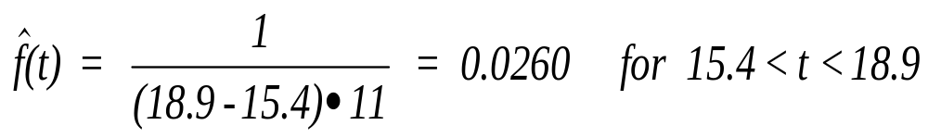
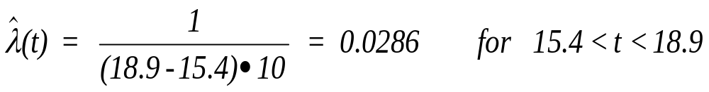
Example 12.2
Chapter 12
Notes:
Here are some example calculations.

Slide 16
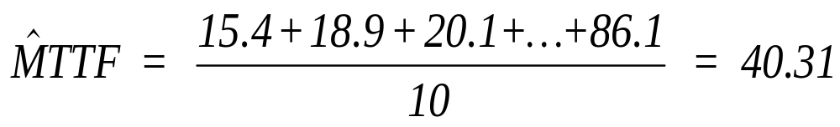
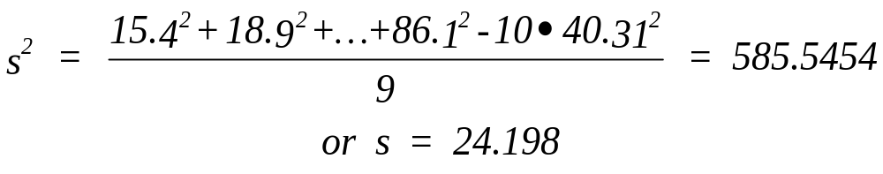
Example 12.2
40.31 ± 1.833 x 24.198/√10 = [26.284, 54.34] is a 90 percent
confidence interval where t._{05,9} = 1.833 from Appendix 12-B.
Chapter 12
Notes:
Review your statistic book on generating confidence intervals for a population mean if you are unsure of the methodology.

Slide 17
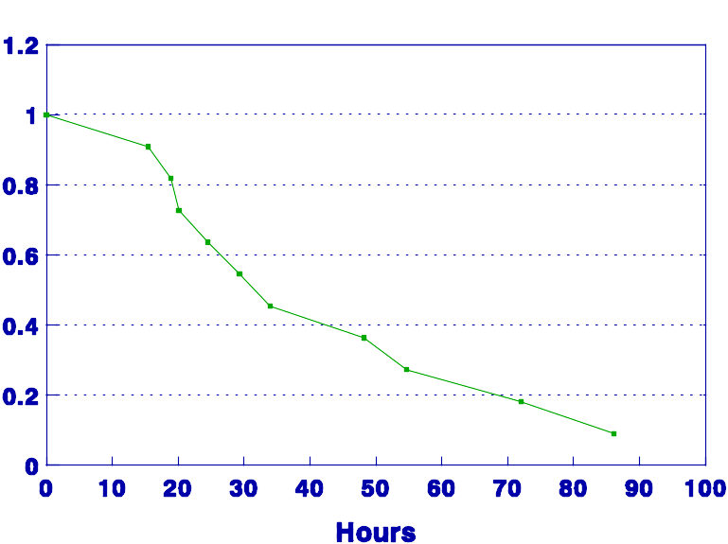
Example 12.2
reliability
step
function
Chapter 12
Notes:
The reliability curve can be plotted. Some textbook use a step function showing a drop in reliability at each failure time. Our textbook plots the curve as continuous.

Slide 18
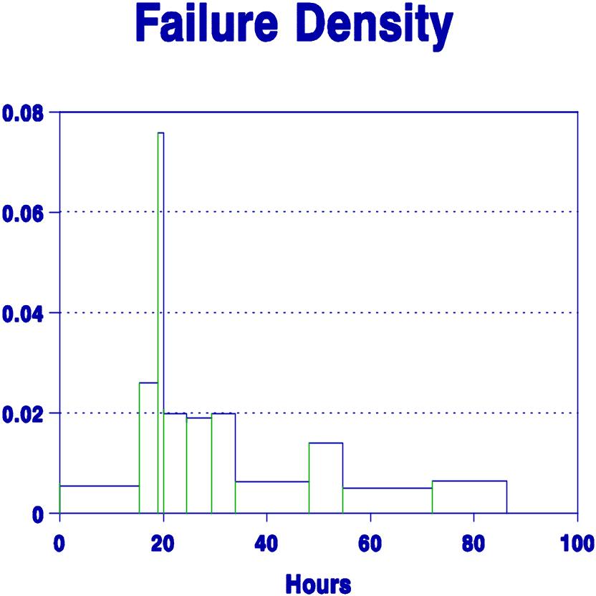
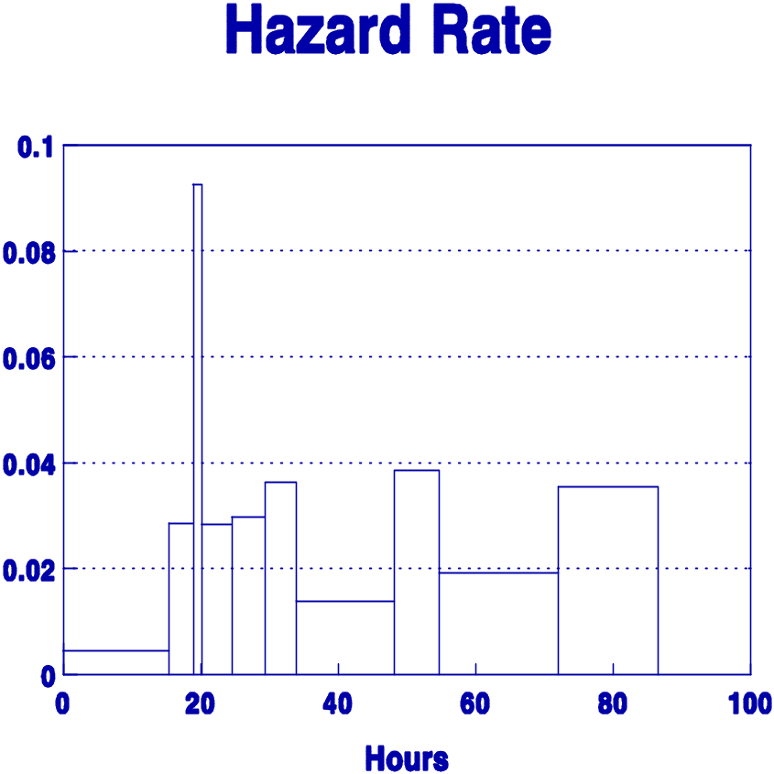
Example 12.2
Chapter 12
Notes:
Generally the PDF and hazard rate function are plotted as histograms.

Slide 19
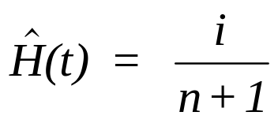
Example 12.3
The following repair times in hours were observed as part of a maintainability demonstration on a new packaging machine:
5, 6.2, 2.3, 3.5, 2.7, 8.9, 5.4, 4.6.
i Repair Time i / (8+1)
1 2.3 .111
2 2.7 .222
3 3.5 .333
4 4.6 .444
5 5.0 .556
6 5.4 .667
7 6.2 .777
8 8.9 .889
After rank ordering
the data:
fewer than 90%
repaired in 8 hrs
Chapter 12
Notes:
For repair sample times, we are usually interested in estimating the CDF. In this example, the mean plotting position is used and a confidence interval computed for the MTTR.

Slide 20
Chapter 12
Data Collection and Empirical Methods
  Ungrouped Complete Data
  Grouped Complete Data
Notes:
The focus changes now from one of developing and analyzing reliability and maintainability models to the analysis of failure and repair data. We begin by establishing some empirical reliabilities generated directly from failure data that has been collected. Later, we will fit theoretical failure distributions to this same failure data.

Slide 21
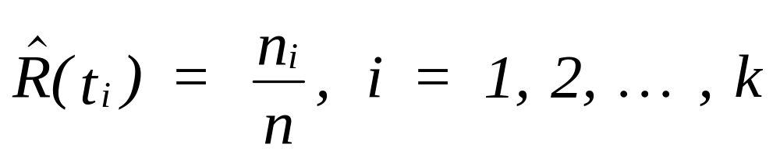
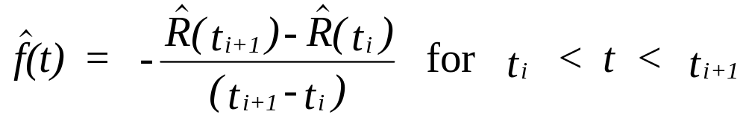
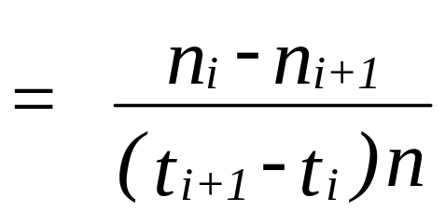
Grouped Complete Data
Let n₁, n₂, ..., n_{k} be the number of units having
survived at ordered times t₁, t₂, ..., t_{k} respectively.
Chapter 12
Notes:
For grouped data, all that is assumed known are the number of failures (or survivors) that occurred at (by) time t. Individual failure times are not known. The empirical reliability function is simply the number of survivors at time t divided by the original number at risk. With grouped data, the sample sizes are generally larger, and, as a result, we divide n_{i} by n and not (n-1).

Slide 22
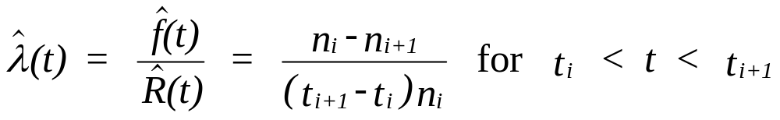
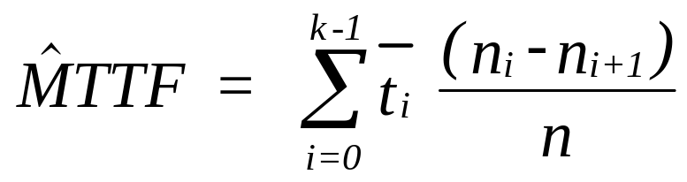
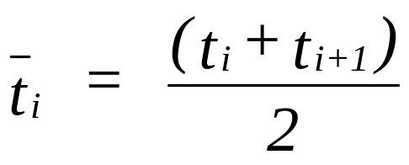
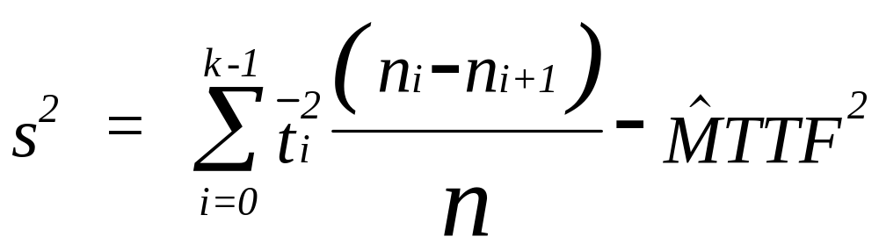
Grouped Complete Data
where
Chapter 12
Notes:
Shown are the formulae for computing an empirical hazard rate function, the sample MTTF and variance. For grouped data, the midpoint of each interval of time is used as the “typical” time for that interval. This implies that failures occur uniformly throughout the interval.

Slide 23
Example 12.4
Seventy compressors are observed at 5 month intervals
with the following number of failures: 3, 7, 8, 9, 13, 18, and 12.
UPPER NBR NUMBER RELI- FAILURE HAZARD
BND FAIL SURVIVE ABILITY DENSITY RATE
0 0 70 1.000 .0086 .0086
5 3 67 .957 .0200 .0209
10 7 60 .857 .0229 .0267
15 8 52 .743 .0257 .0346
20 9 43 .614 .0371 .0605
25 13 30 .429 .0514 .1200
30 18 12 .171 .0343 .2000
35 12 0 0.000
Chapter 12
Notes:
A numerical example.

Slide 24
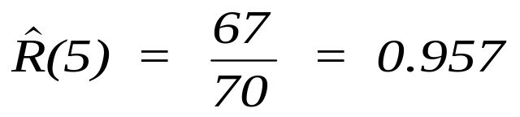
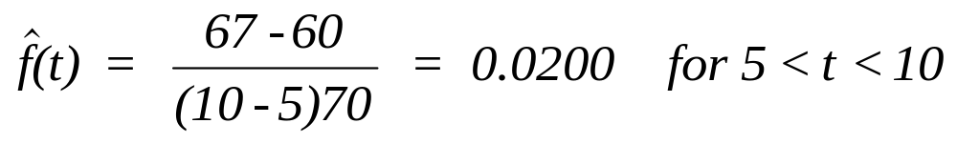
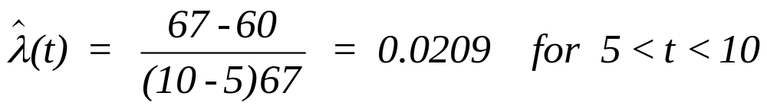
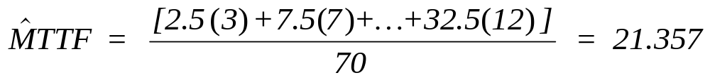
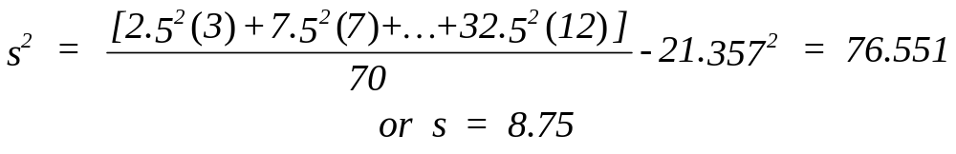
Example 12.4
Chapter 12
Notes:
The example continued.

Slide 25
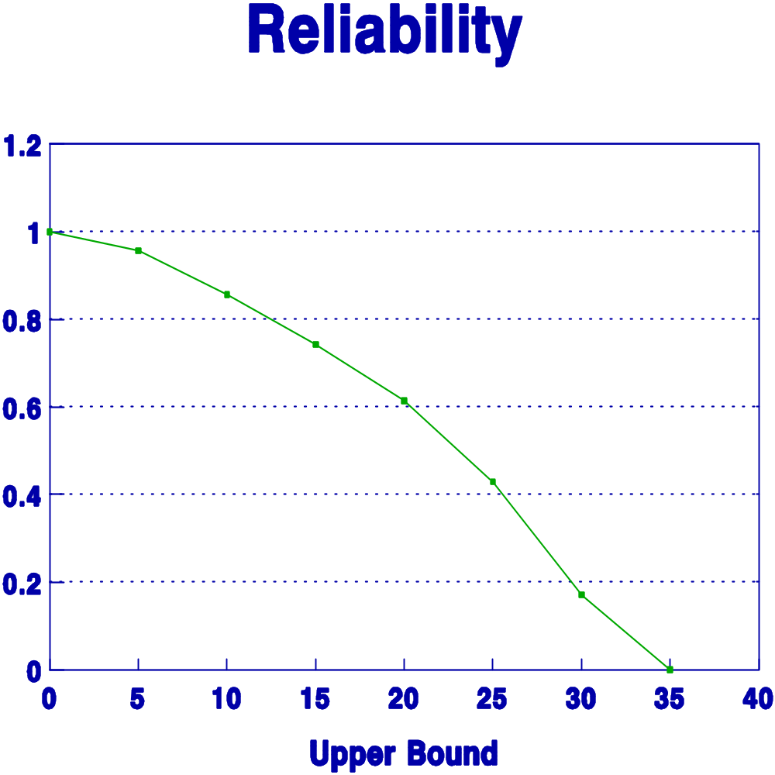
Example 12.4
Chapter 12
Notes:
The reliability function is plotted using line segments where the i^{th} point is (n_{i}/n, t_{i}).

Slide 26
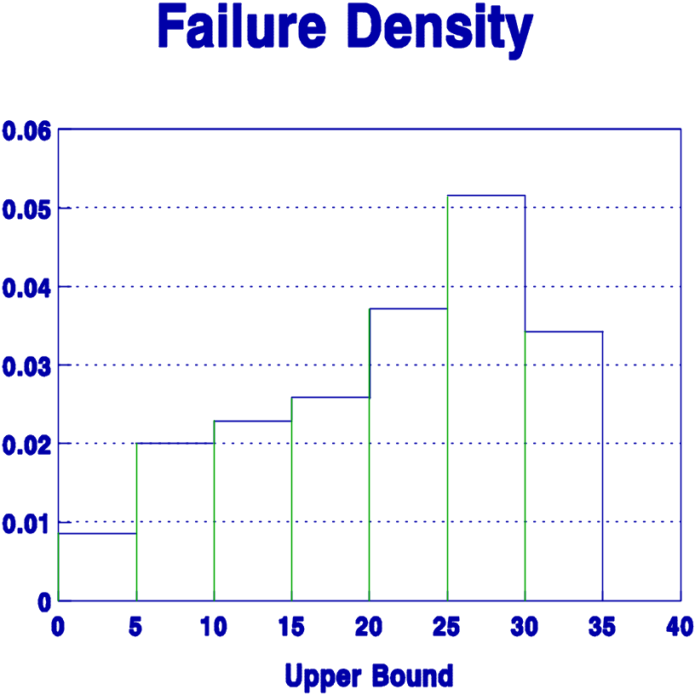
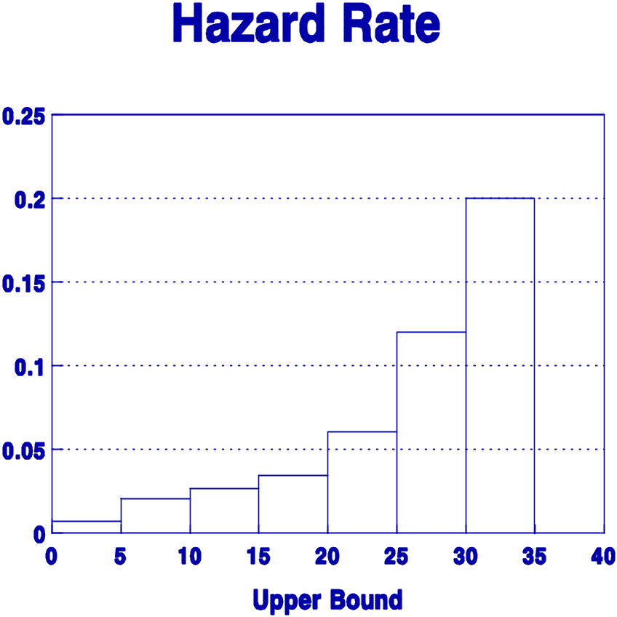
Example 12.4
Chapter 12
Notes:
The PDF and hazard rate functions are plotted as histograms.

Slide 27
Example 12.5
The following aircraft repair data reported by the
maintenance organization shows the number of days an
aircraft was out of service because of unscheduled maintenance.
Days Number of Aircraft
1-2 4
3-4 7
5-6 9
7-8 6
9-10 4
total 30 repairs
Chapter 12
Notes:
An example using grouped repair data.

Slide 28
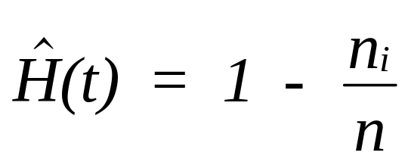
Example 12.5
where n_{i} is the number of
repairs exceeding time t_{i}
i Upper Bnd (t_{i}) n_{i} 1 - n_{i} / 30
1 2 days 26 .133
2 4 days 19 .367
3 6 days 10 .667
4 8 days 4 .867
5 10 days 0 1.00
estimated MTTR = 4.9 days with s = 2.44
Chapter 12
Notes:
As with the ungrouped data, the interest is in estimating the CDF.

